Slide 1

Cognitive Load Theory
ITTECF reference – Standard 2 – Promote good progress

Slide 2
Split attention demonstration
Time how long it take you to:
Write out all the numbers from 1 to 26 in order, left to right.
---THEN---
Write out all the letters from A to Z in order, left to right.
Make a note of how long that took.

Slide 3
Split attention demonstration
Without looking at your previous work…
Time how long it takes you to:
Write out A1, B2, C3 through to Z26, in order, left to right.
Compare with your previous time.

Slide 4
Practical work and cognitive load
Think about the practical activity you designed yesterday
What are you asking of pupils in terms of cognitive load? (For example, following instructions, applying learning.)

Slide 5
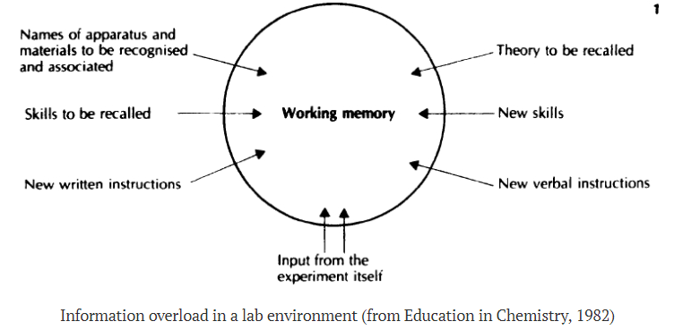
Practical work – a hard ask for students
Clark, R., Nguyen, F. & Sweller, J. (2006) Efficiency in Learning: Evidence-Based Guidelines to Manage Cognitive Load. John Wiley & Sons.

Slide 6
Cognitive Load Theory (CLT)
What is happening in the working memory? Three types of load…
Intrinsic
complexity of concepts
Extraneous
complexity of the instructional materials
Germane
building the mental models (schema) about the concepts
external influences
inter-relatedness of ideas
.
Notes:
https://impact.chartered.college/article/shibli-cognitive-load-theory-classroom/

Slide 7
Intrinsic load
Intrinsic load is set by the nature of the content - complex tasks with many interacting elements have a high intrinsic load, while simpler tasks have a lower intrinsic load
Science practicals often have high intrinsic load, as they involve complex tasks with multiple steps and concepts to process simultaneously.

Slide 8
Extrinsic load
Extrinsic load is generated by features unrelated to the subject's inherent difficulty - think background noise, distracting displays, overly complex resources, split-attention between multiple sources, or confusing instructions.
When science practicals have poorly structured instructions, unfamiliar equipment, or confusing setups it can increase extraneous cognitive load, distracting from the main learning objectives.

Slide 9
Germane load
Germane load is the portion of working memory actively dedicated to constructing, organising, and automating knowledge structures (schemas) from new information.
Science practicals can promote germane load by encouraging pupils to build and refine scientific schema through active engagement - such as hypothesising, experimenting, and making connections with theory.
What strategies could you use to manage cognitive load in practical science work?

Slide 10

Strategies to manage cognitive load
Pre-teaching techniques: Teaching the underlying theory and any unfamiliar technical skills beforehand allows pupils to focus on the application rather than wrestling with the basics during the practical.
Stepwise instructions: Breaking tasks into clearly defined steps, using visual aids, and minimising unnecessary detail keeps pupils focused and reduces potential overload.
Demonstrations vs. inquiry: Whole-class demonstrations may be more effective for complex techniques, whereas inquiry-based practicals work best when pupils already possess solid background knowledge.
Slow practicals: Encouraging deliberate, stepwise problem-solving - with time for explicit thinking - can transform practicals into powerful learning experiences that optimise cognitive load.

Slide 11
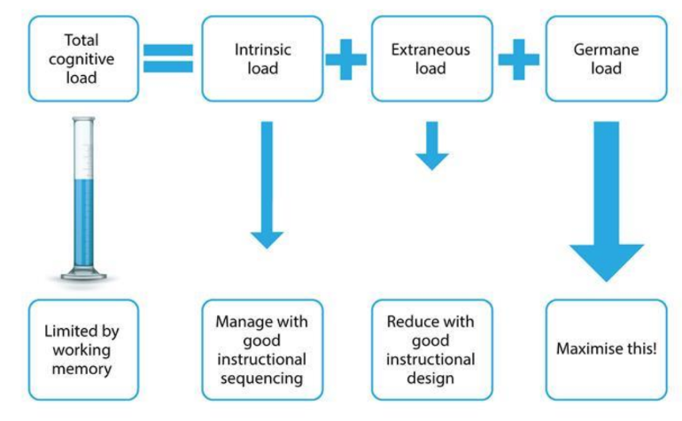
Cognitive Load Theory (CLT)
Greer, D.L., et al, Cognitive theory of multimedia learning…, Journal of Education, 2013, 193(2), 41-50
https://www.researchgate.net/publication/269112838
Notes:
https://eic.rsc.org/feature/improving-practical-work-with-integrated-instructions/3009798.article

Slide 12
Managing cognitive load in science teaching
Lesson planning
Sequencing
Instructional clarity
Presentation
Worked examples
Modelling
Scaffolding
Chunking
Curriculum design

Slide 13
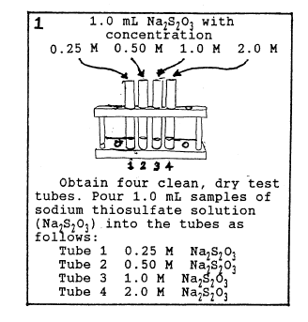
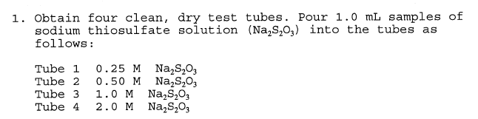
Integrated Instructions: Reduce cognitive load Support independence Improve accuracy and efficiency Enhance understanding
Deschri et al (1997), J Res Sci Teach, 34(9), 891-904: Effect of a Laboratory Manual Design Incorporating Visual
Information-Processing Aids on Student Learning and Attitudes

Slide 14


Making integrated instructions
https://eic.rsc.org/feature/improving-practical-work-with-integrated-instructions/3009798.article

Slide 15
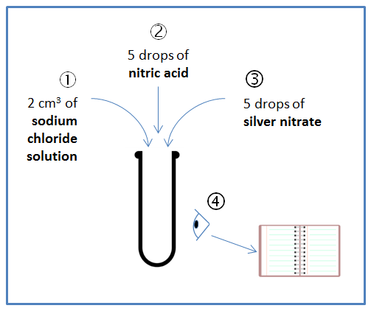
Integrated Instructions
Add 2 cm³ of 0.2 M sodium chloride solution to a test tube.
Add 5 drops of 0.5 M nitric acid to the same test tube.
Add 5 drops of 0.1 M silver nitrate solution to the same test tube.
Make and record your observations.

Slide 16
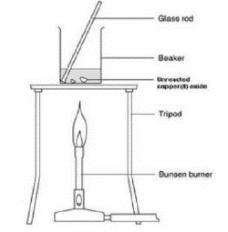
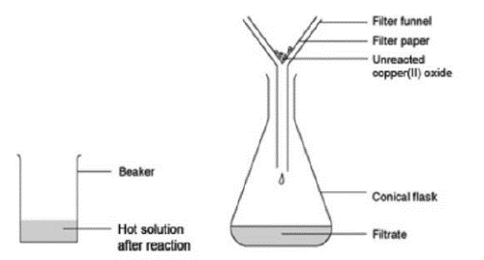
Split attention in practical work
a Add 20 cm3 of the 0.5 M sulfuric acid to the 100 cm3 beaker. Heat carefully on the tripod with a gentle blue flame until nearly boiling.
b When the acid is hot enough (just before it starts to boil), use a spatula to add small portions of
copper(II) oxide to the beaker. Stir the mixture gently for up to half a minute after each addition.
c When all the copper(II) oxide has been added, continue to heat gently for 1 to 2 minutes to ensure reaction is complete. Then turn out the Bunsen burner. It may be wise to check (using pH or litmus paper) that no acid remains. If the acid has not been hot enough, excess acid can co-exist with copper oxide.
d Allow the beaker to cool slightly while you set up Stage 2.
Stage 2
e Place the filter funnel in the neck of the conical flask.
f Fold the filter paper to fit the filter funnel, and put it in the funnel.
g Make sure the beaker is cool enough to hold at the top. The contents should still be hot.
h Gently swirl the contents to mix, and then pour into the filter paper in the funnel. Allow to filter through.
i A clear blue solution should collect in the flask. If the solution is not clear, and black powder remains in it, you will need to repeat the filtration.
Stage 3 (optional)
j Rinse the beaker, and pour the clear blue solution back into it. Label the beaker with your name(s). Leave the beaker in a warm place, where it won't be disturbed, for a week or so. This will enable most of the water to evaporate. would fill with toxic fumes.
k Before all the water has evaporated, you should find some crystals forming on the bottom of the
beaker. Filter the solution. Collect the crystals from the filter paper onto a paper towel.
http://www.rsc.org/learn-chemistry/resource/res00001917/reacting-copper-ii-oxide-with-sulfuric-acid?cmpid=CMP00006703
Cook, M.P., 2006. Visual representations in science education: The influence of prior knowledge and cognitive load theory on instructional design principles. Science education, 90(6), pp.1073-1091.

Slide 17
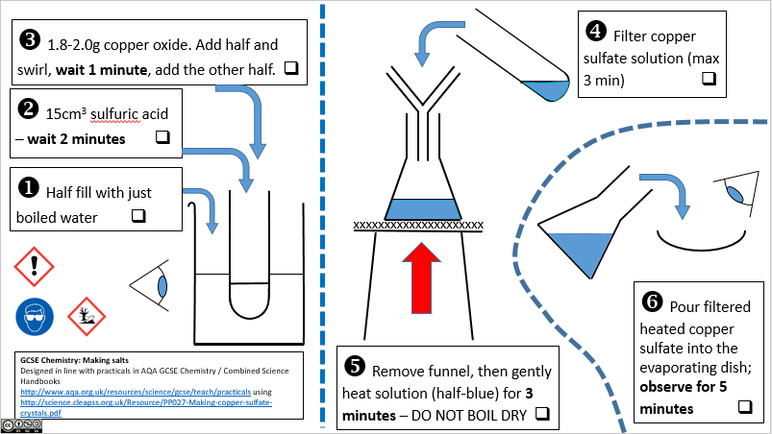
Integrated-instructions in practical work

Slide 18
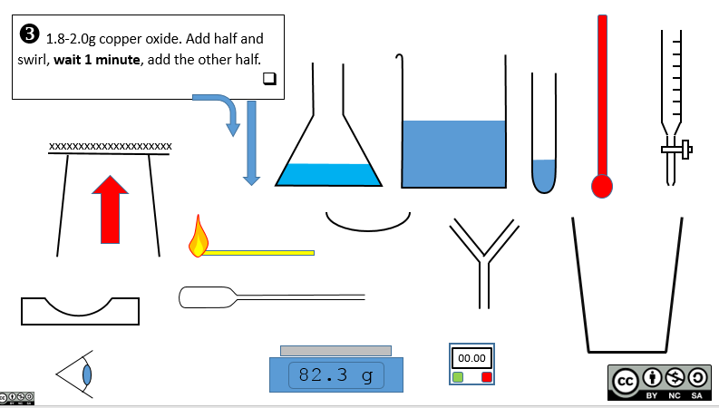
Making integrated instructions
https://dave2004b.wordpress.com/2018/02/25/integrated-instructions-templates/

Slide 19
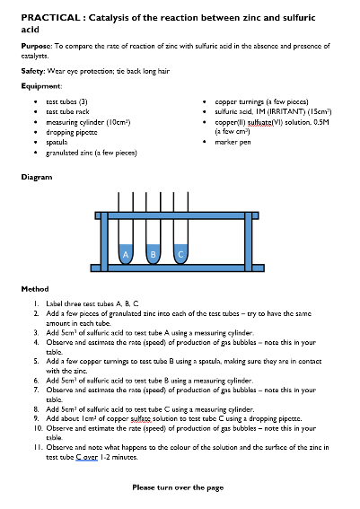
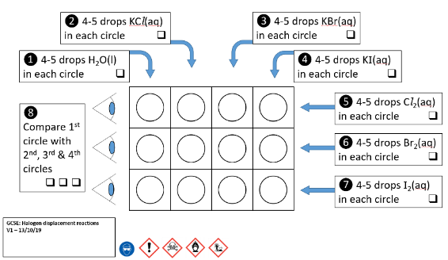
Year 9: Traditional vs Integrated

Slide 20
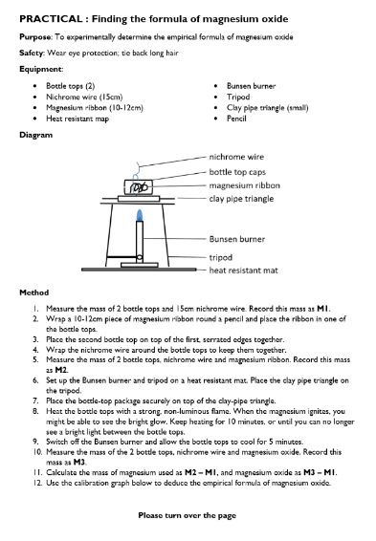
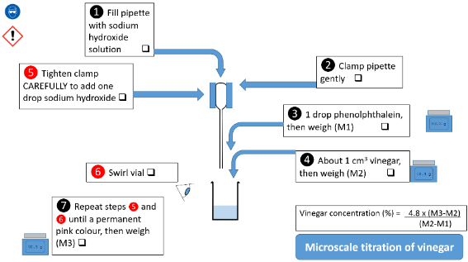
Year 12: Traditional vs Integrated

Slide 21
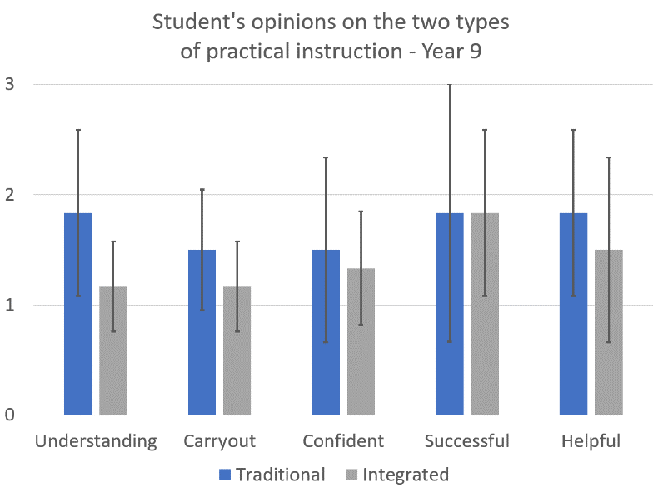
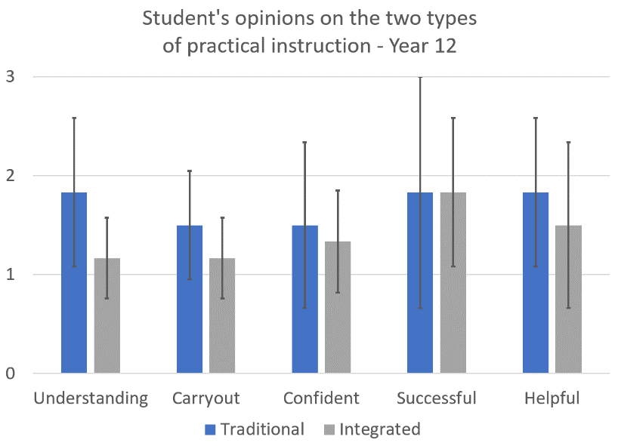
Student opinions of different practical types
lower is better
Understanding – How easy/hard did you find it to understand the practical instructions?
Carryout – How easy/hard did you find it to carry out the practical work?
Confident – How confident did you feel during the practical work?
Successful – How successful did you feel at the end of the practical?
Helpful – How helpful was the practical in your learning?

Slide 22
Planning support
Can you create a set of integrated instructions for your chosen practical activity?
Share these with another group.
Peer assess:
Would you be able to follow these instructions without asking any questions?

Slide 23
References
Clark, R., Nguyen, F. & Sweller, J. (2006) Efficiency in Learning: Evidence-Based Guidelines to Manage Cognitive Load. John Wiley & Sons.
Cook, M.P., 2006. Visual representations in science education: The influence of prior knowledge and cognitive load theory on instructional design principles. Science education, 90(6), pp.1073-1091.
Donker, A. S., de Boer, H., Kostons, D., Dignath van Ewijk, C. C., & van der Werf, M. P. C. (2014) Effectiveness of learning strategy instruction on academic performance: A meta-analysis. Educational Research Review, 11, 1–26. https://doi.org/10.1016/j.edurev.2013.11.002.
Paterson, D.J., 2019. Design and evaluation of integrated instructions in secondary-level chemistry practical work. Journal of Chemical Education, 96(11), pp.2510-2517. (Not available for full text view)
Rosenshine, B. (2012) Principles of Instruction: Research-based strategies that all teachers should know. American Educator, 12–20
Sweller, J., (1988). Cognitive load during problem solving: Effects on learning. Cognitive science, 12(2), pp.257-285.
Sweller, J., Van Merrienboer, J.J. and Paas, F.G., 1998. Cognitive architecture and instructional design. Educational psychology review, 10(3), pp.251-296.

Slide 24
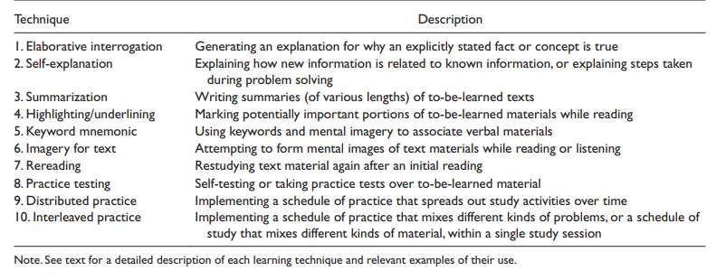
Exemplar metacognitive strategies which can reduce cognitive load
Donker, A. S., de Boer, H., Kostons, D., Dignath van Ewijk, C. C., & van der Werf, M. P. C. (2014) Effectiveness of learning strategy instruction on academic performance: A meta-analysis. Educational Research Review, 11, 1–26. https://doi.org/10.1016/j.edurev.2013.11.002. (Table taken from p6)

Slide 25
How do you reduce extraneous load
technique | Description | Impact
Worked example | Replaces conventional problems and crutches with worked examples. | Reduces extraneous load by exemplifying key steps to problems.
Completion effect (faded examples) | Replace conventional problems with worked examples where certain steps are missing | Reduces extraneous load by gradually giving different parts of the problem allowing time to embed each step
Split attention effect
Modality effect | Remove excess text from slides use visual cues with narration to explain concepts | Reduces extraneous load as the multimodal presentation visual and auditory processors
Goal free effect | Replace conventional problems with goal free problems which provide students with non specific goal | Reduces extraneous load caused by relating a problem to a specific goal
Redundancy effect | Replace multiple sources of information and distractors | Reduces extraneous load caused by unnecessarily processing redundant information

Slide 26

Journal of Chemical Education article

